Slide 1

Presentation Materials Created by Mimetics Inc.
Free use by anyone for non-commercial purposes
Copyrights, Trademarks and other Registered Marks the Property of their Owners

Slide 2
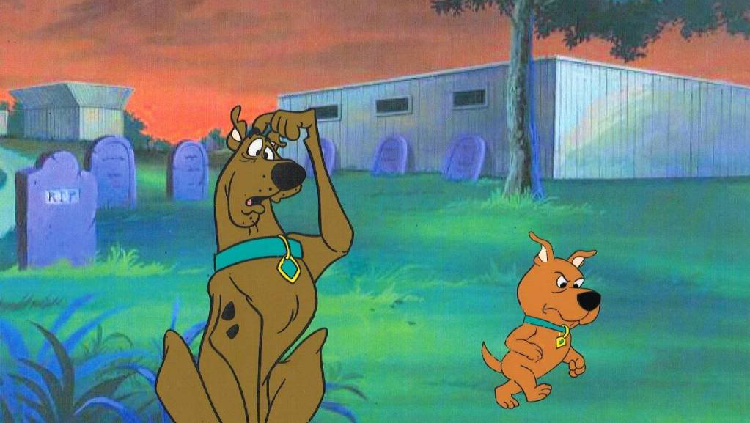
Grade 6 – Scratch Programming 3
Movement with the Jade Robot
Notes:
We want to introduce the Jade Robot and it’s Tools in more detail along with our action plans for it.
It’s interesting, but it’s easy to criticize something when it’s done (especially when you have experience) – a *LOT* more difficult getting it right from the start. Also, preparing this presentation was a great way to review and think about what we should be doing.

Slide 3
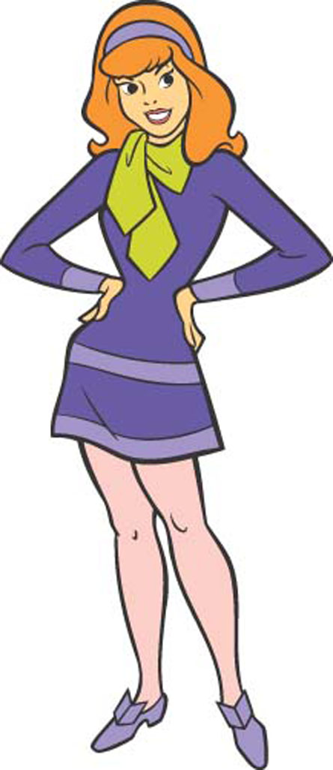
Recap
Where is “0, 0” on the Jade Robot Display?
What are the Colours you can Draw on the Jade Robot Display?
What are the Basic Jade Robot Movements?
Notes:
Can Demo Jade Scratch if people are interested. In doing this product I’ve had a few interesting discoveries – one was going with a simpler programming language actually has a *LOT* of value for an expert like myself.

Slide 4

Creating a Program
Get the Requirements
Break the Requirements into Parts
For Each Part, List the Statement Types Needed
For Each Part, Create a Sequence of Statements
Test the Statements for Each Part
Work in Sequence and Build Up the Program as the Sum of the Parts
Test the Final Program to the Requirements
Celebrate!!!
Notes:
Can Demo Jade Scratch if people are interested. In doing this product I’ve had a few interesting discoveries – one was going with a simpler programming language actually has a *LOT* of value for an expert like myself.

Slide 5
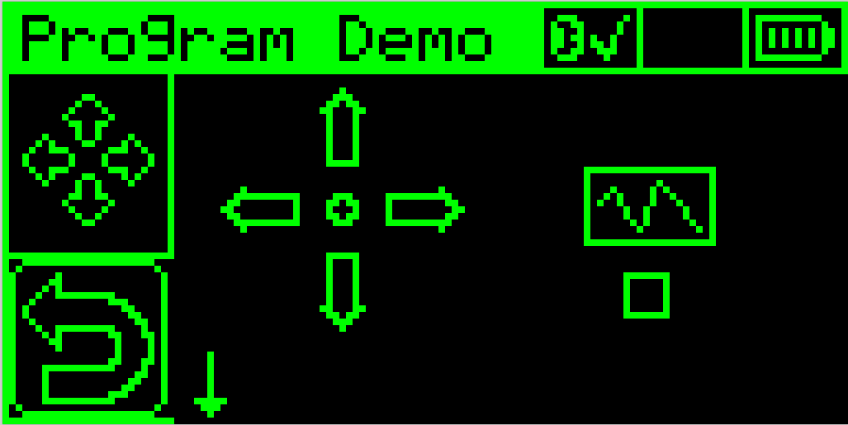
Simple Programming
Movement Selection
Execution Start
You can Create Your Own Program
Use the White (and Red) Buttons to Create a Program
Go to the Centre Control to Try the Program
User Interface is Disabled When you are Connected to Jade Support
Disconnect to Enable UI
Reconnect for Scratch Program
Entered Program
Do Spectrometer
Reading at End
Notes:
Ask “What is a Program”?

Slide 6

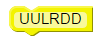
Movement Programming Challenge 1
1. Using “PgmDemo” Create a Program that Moves the Jade Robot.
2. In Jade Support, Document the Program as a “Comment” with
U – Forwards
D – Reverse
L – Left
R – Right
Notes:
Can Demo Jade Scratch if people are interested. In doing this product I’ve had a few interesting discoveries – one was going with a simpler programming language actually has a *LOT* of value for an expert like myself.

Slide 7
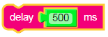
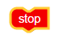
Movement Programming Challenge 1
3. Create a Scratch Program that Matches the PgmDemo Program
Remember, Each Arrow Executes for 500ms
Remember, to
At the End
Notes:
Can Demo Jade Scratch if people are interested. In doing this product I’ve had a few interesting discoveries – one was going with a simpler programming language actually has a *LOT* of value for an expert like myself.

Slide 8
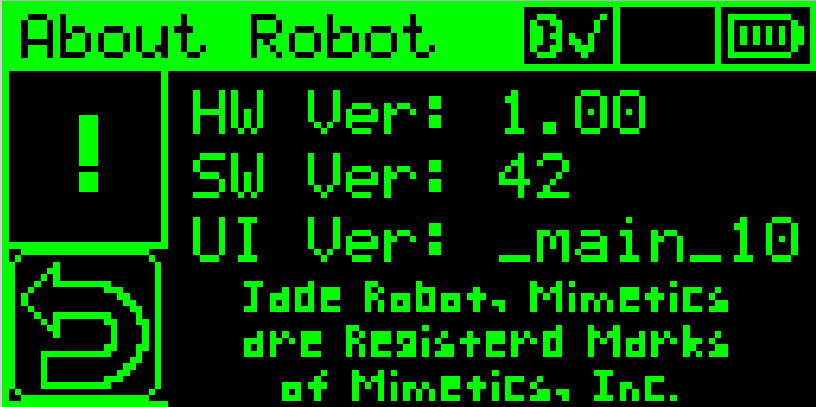
OLED Display
Origin (0,0)
End (127, 63)
Notes:
Can Demo Jade Scratch if people are interested. In doing this product I’ve had a few interesting discoveries – one was going with a simpler programming language actually has a *LOT* of value for an expert like myself.

Slide 9
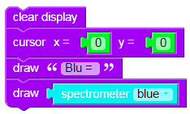
Movement Programming Challenge 2
Using “PgmDemo” Modify Your Program that Moves the Jade Robot to Show the Spectrometer Values at End.
Notes:
Can Demo Jade Scratch if people are interested. In doing this product I’ve had a few interesting discoveries – one was going with a simpler programming language actually has a *LOT* of value for an expert like myself.

Slide 10
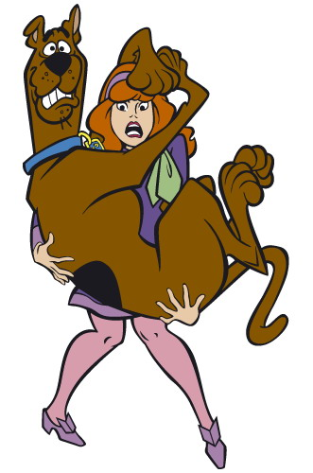
Robot Program Structure
Initialize Robot
Get Input
Process
Repeat (Loop)
Output Processed Inputs
Shutdown Robot
(Stop)
Notes:
Can Demo Jade Scratch if people are interested. In doing this product I’ve had a few interesting discoveries – one was going with a simpler programming language actually has a *LOT* of value for an expert like myself.

Slide 11
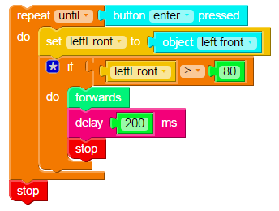
Simple Robot Program
No Initialization
Loop
Get Inputs
Process Inputs
Output Processed Inputs
Shutdown Robot
Notes:
Can Demo Jade Scratch if people are interested. In doing this product I’ve had a few interesting discoveries – one was going with a simpler programming language actually has a *LOT* of value for an expert like myself.

Slide 12

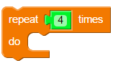
Repeat # Loop
Statements Inside Loop Statement Are Repeated
Four Times
Notes:
Can Demo Jade Scratch if people are interested. In doing this product I’ve had a few interesting discoveries – one was going with a simpler programming language actually has a *LOT* of value for an expert like myself.

Slide 13
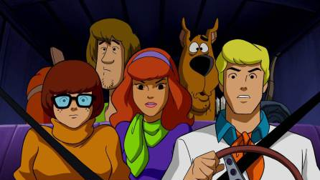
Challenge – Create Movement Program with Repeat
Notes:
Can Demo Jade Scratch if people are interested. In doing this product I’ve had a few interesting discoveries – one was going with a simpler programming language actually has a *LOT* of value for an expert like myself.

